Slide 1
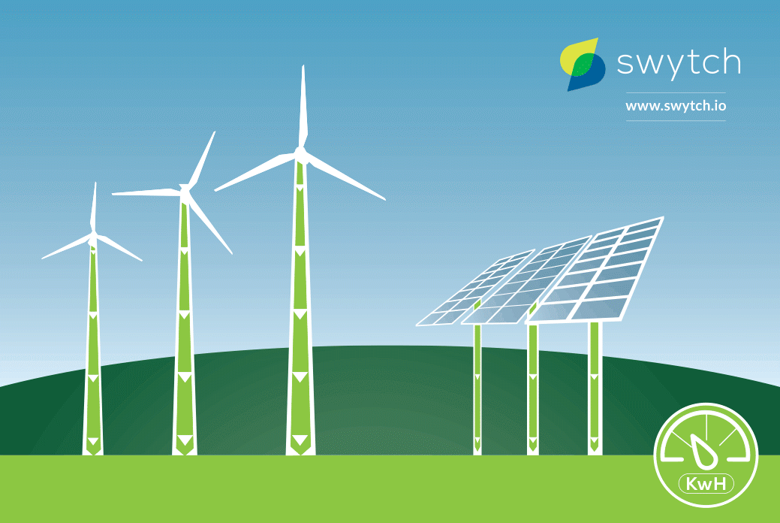
Wind and Solar Energy
Wind and Solar Energy
Wind and Solar Energy
Year 11
Population and resources

Slide 2
Learning objectives:
To understand how engineers use wind and solar radiation to generate electricity
To explain the ways to generate energy from solar radiation and wind
To analyze the capacity of the areas to produce energy
To compare the advantages and disadvantages of these energy sources with fossil fuels

Slide 3
Why is improving the ways in which we generate electricity important?
Brief Information
Wind is a renewable energy resource. Wind turbines are used to convert wind energy into electricity. A turbine consists of blades attached to a central hub. The blades on the turbines are designed to be easily turned by the wind. The turbine is connected to a generator. As the wind turns the blades on the turbine, the turbine turns the generator. The generator converts the mechanical energy of the moving turbine into electrical energy. The design of the blades is very important in making the turbine efficient. Efficient turbines mean that more electricity can be produced from the same amount of wind.
In an electrical system, there is a generator or source of electricity, a way to transmit that electricity, and an end use for that electricity. The farther the distance from the generator to the end use, the greater is the resistance along the transmission wire. Thus, the farther the electricity has to travel from the battery or other source, the more electricity is lost along the way

Slide 4
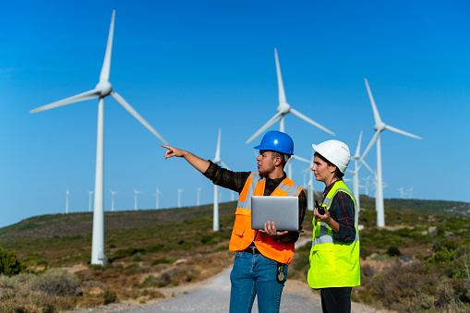
Think like an engineer:
What
Geographic factors (location, relief, proximity to the settlement, sustainability, etc)
Biological factors (the impact of the wind turbines on living things in the area)
Human factors (demand, advantages or disadvantages for people)
Financial and technical factors (the costs of construction, maintenance, and duration of exploitation)
Energy efficiency factors (wind speed and energy capacity, etc.)
Should you take into consideration in power plant construction?
Which areas are more convenient to build wind turbines in Azerbaijan?
Work in groups: you have 20 minutes to complete it.
1. Take the A3 paper and list the factors in the list above
2. You can use the Internet
3. You can use the resources posted in Week 13 Lesson 1.
4. Demonstrate your worksheet

Slide 5
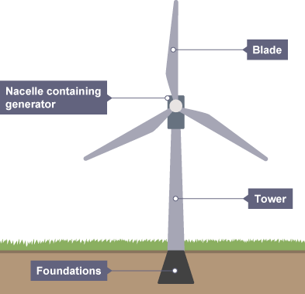
Wind energy
The wind is produced as a result of large movements of air, driven by energy from the Sun. This means that the kinetic energy in wind is a renewable energy resource. As long as the Sun exists, the wind will too.
Wind turbines
Wind turbines use the wind to drive turbines directly. They have huge blades mounted on a tall tower. The blades are connected to a 'nacelle', or housing, which contains gears linked to a generator. As the wind blows, it transfers some of its kinetic energy to the blades, which turn and drive the generator.
The main features of a wind turbine

Slide 6
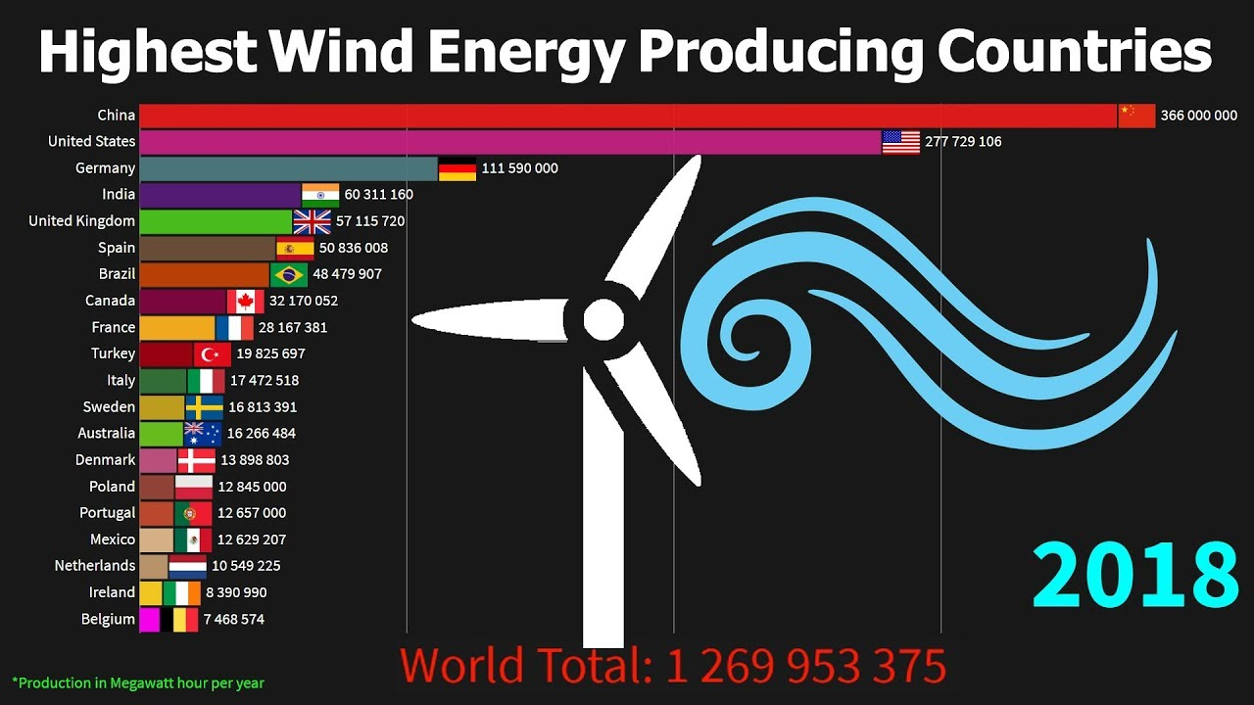

Slide 7
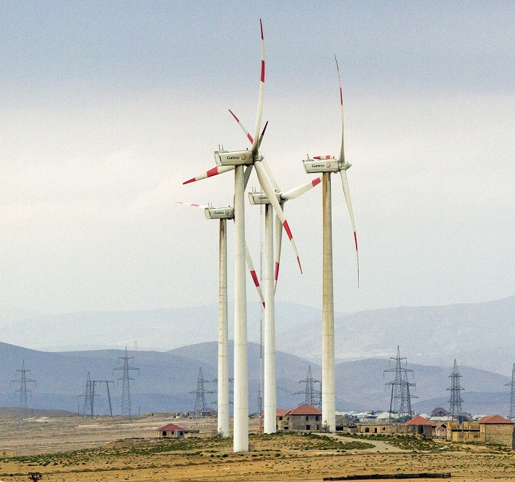
Advantages
Wind is a renewable energy resource. There are no fuel costs and no harmful polluting gases are produced.
Disadvantages
Wind farms are noisy and may spoil the view for people living near them.
The amount of electricity generated depends on the strength of the wind. If there is no wind, there is no electricity.

Slide 8
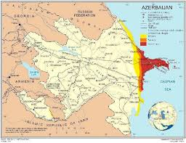
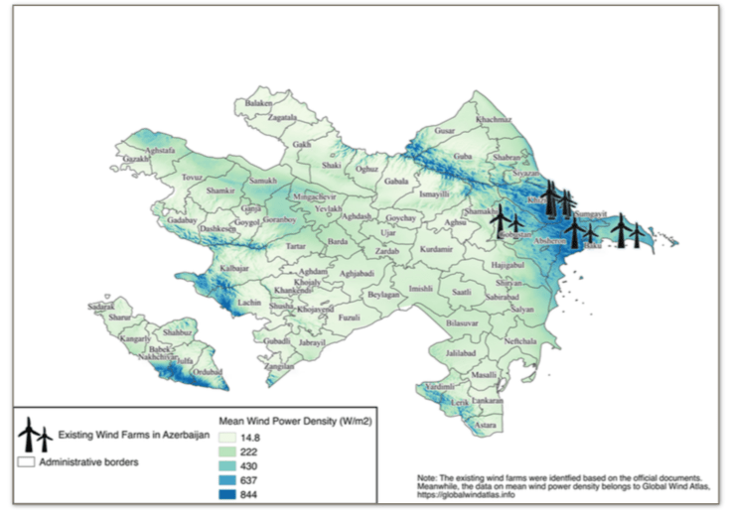
Wind Energy Potential in Azerbaijan

Slide 9
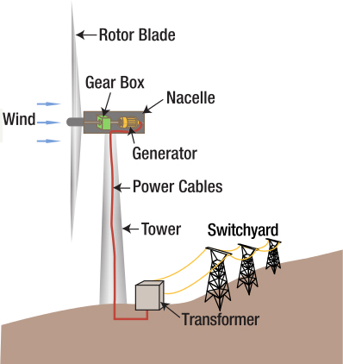
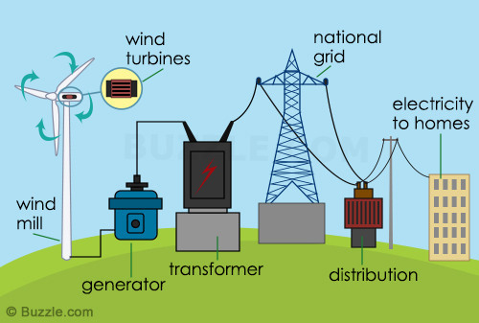
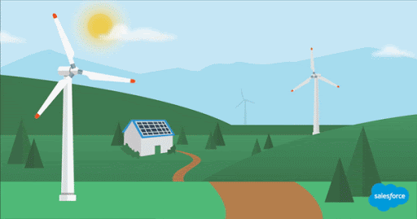
How does a wind turbine work?

Slide 10
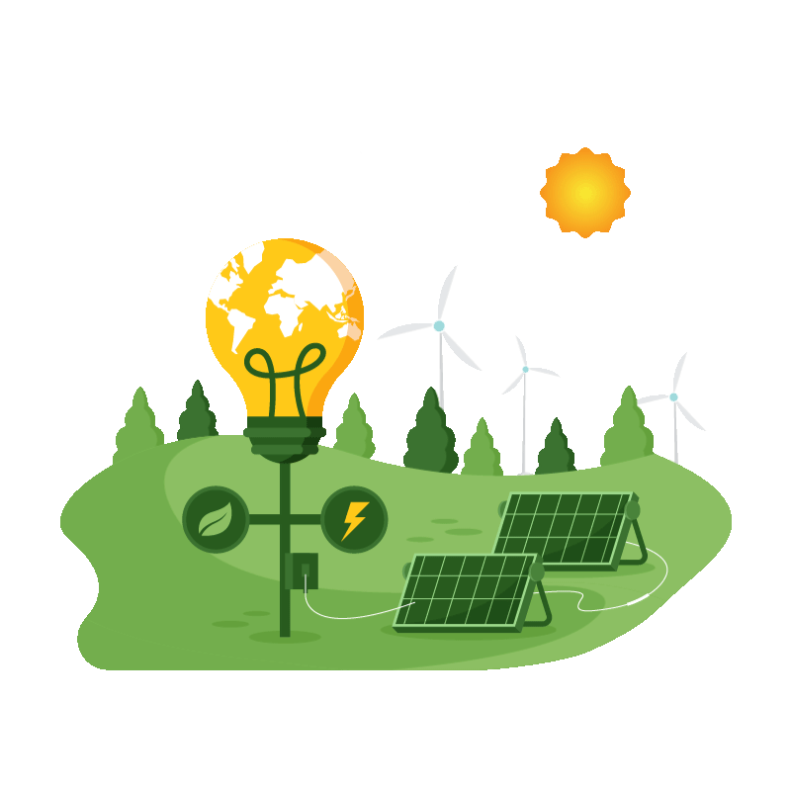
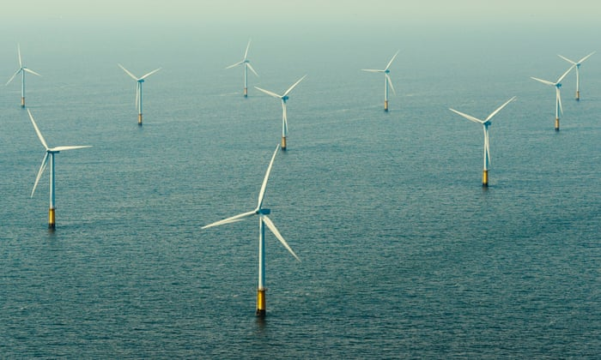
https://globalwindatlas.info/

Slide 11
Solar energy
Solar energy is energy that comes from the Sun .
Solar panels use sunlight to make electricity .
Solar energy is renewable and therefore better for the environment.

Slide 12
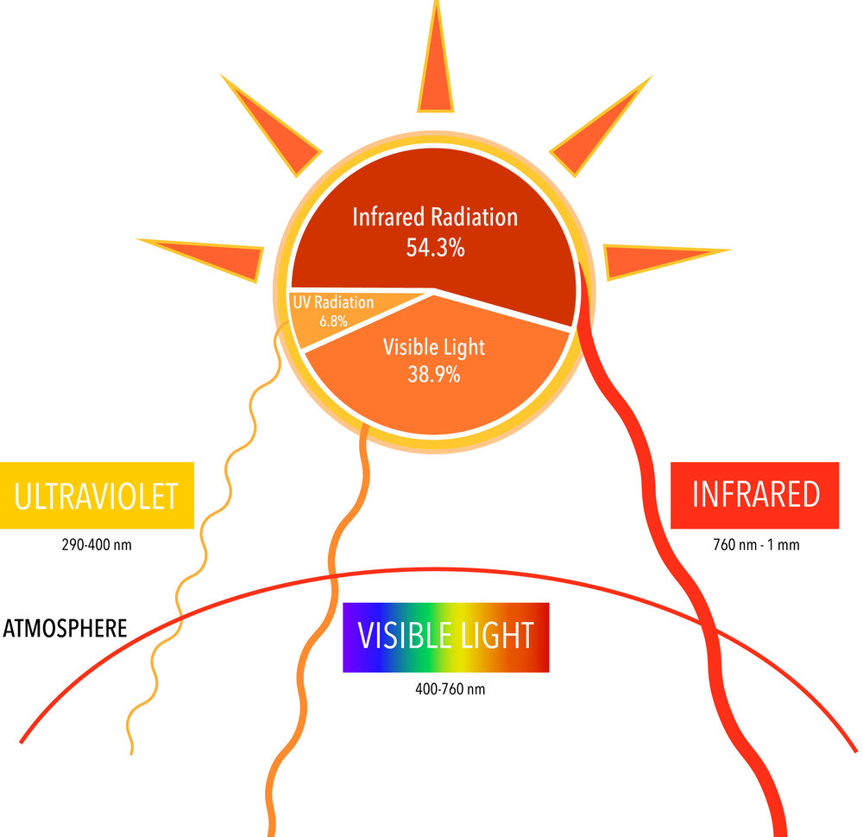
What is solar energy?
Solar energy is energy in the form of light, produced by the Sun.
Light from the Sun comes as ultraviolet , visible and infra red rays. Visible light is the spectrum of colours we are used to seeing but ultraviolet and infrared cannot be seen.

Slide 13
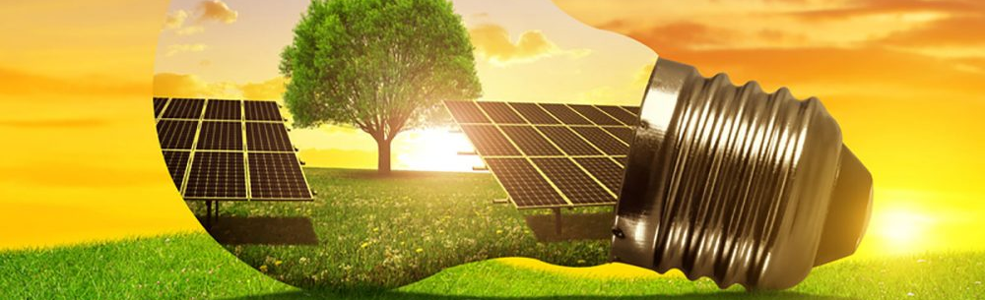
Why is it important to use solar energy?
Solar energy is a renewable source of energy. It is free and does not damage the environment.
Most electricity is made by burning fossil fuels , which release carbon dioxide and pollution .
Solar energy does not release anything into the air, so it is a clean source of energy and does not damage our planet.

Slide 14
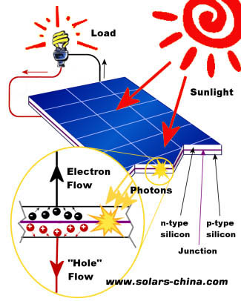
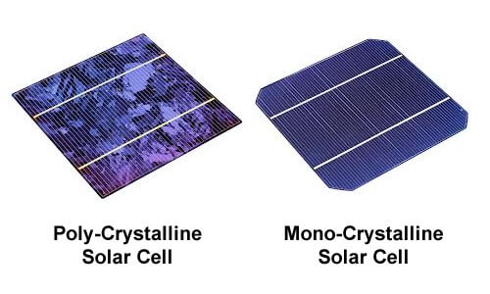
How does solar energy turn into electricity?
When light hits a solar panel it reacts with silicon crystals in each solar panel to produces an electric current .
The electric current can then be fed into the National Grid .
The National Grid is the system of cables and wires that transfer electricity from power stations to houses and businesses across the country.

Slide 15
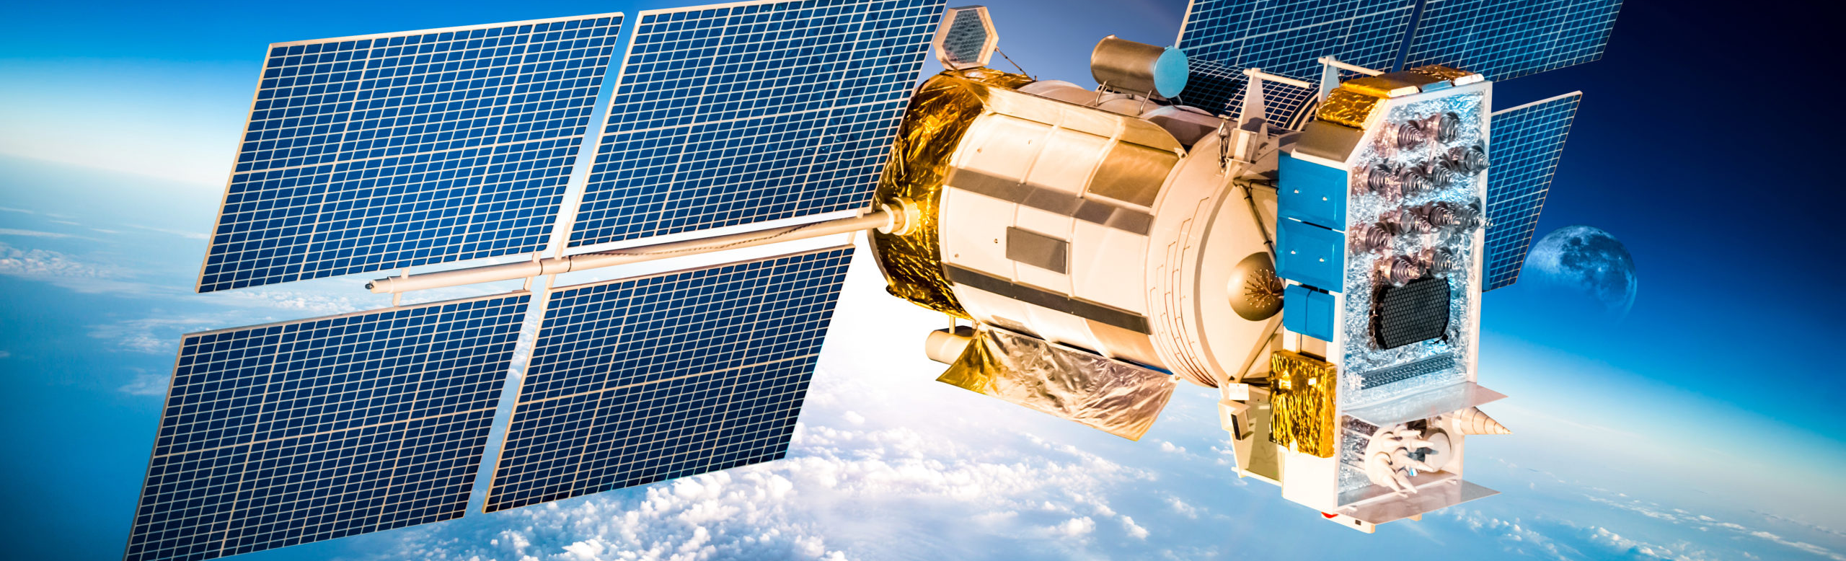
Solar energy put to good use
Space engineers include solar panels on satellites to produce the energy needed to run their electric circuits.
This is because it is not possible to provide further fuel to the satellites after they have launched, they need to capture the free energy from the Sun.

Slide 16
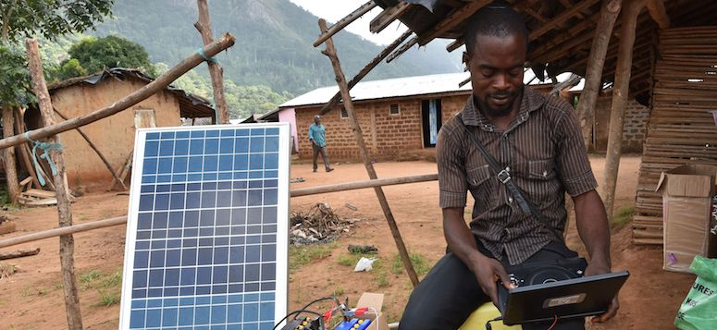
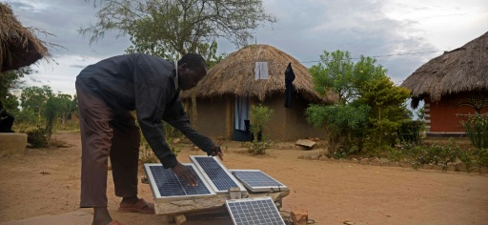
Advantages
Solar energy is a renewable energy resource.
There are no fuel costs and no harmful polluting gases are produced.
Solar cells can provide electricity in remote locations where there is no mains electricity.
Disadvantages
Solar cells are expensive and inefficient, so the cost of their electricity is high.
Solar cells do not work at night and not as well when it is cloudy.

Slide 17
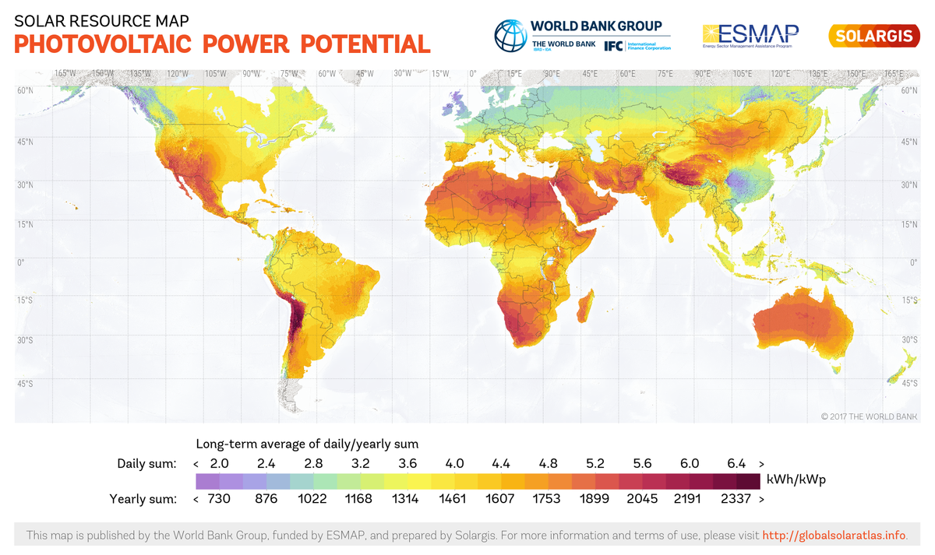
Solar Power

Slide 19
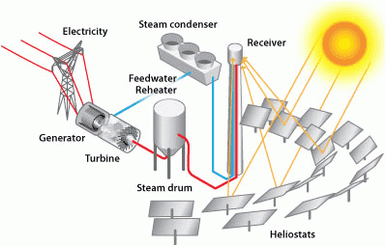
Photovoltaic system and Concentrating Solar Power system

Slide 20
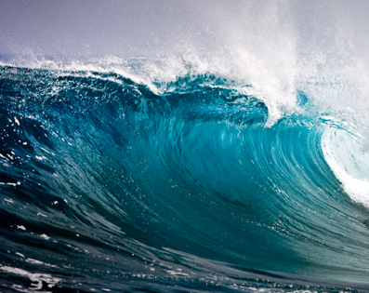
Tidal and wave power

Slide 21
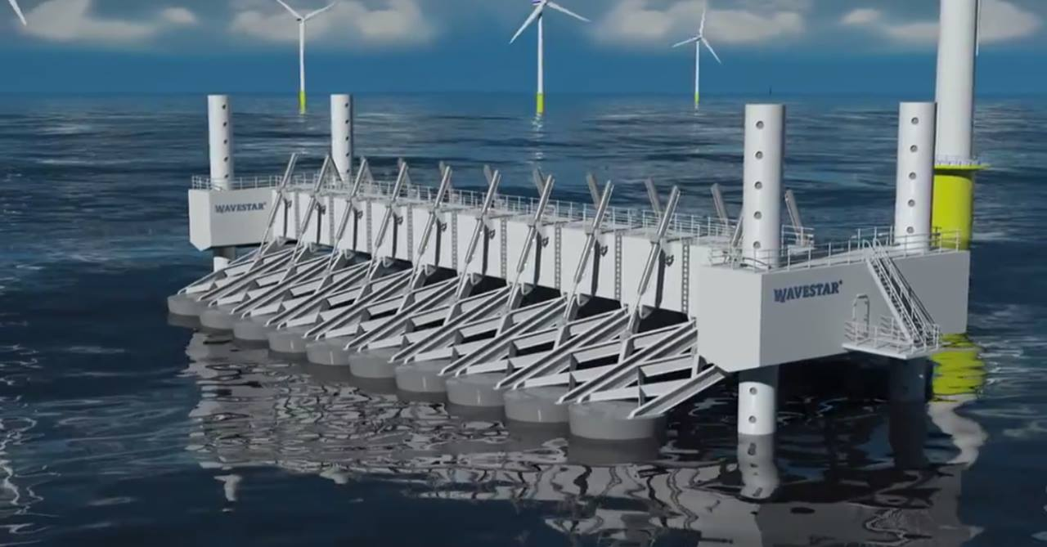

Slide 22

Water energy https://www.youtube.com/watch?v=q8HmRLCgDAI
Like the wind, water can be used to drive turbines directly. There are several ways that water can be used, including waves, tides and falling water in hydroelectric power schemes.
Wave
The water in the sea rises and falls because of waves on the surface. Wave machines use the kinetic energy in this movement to drive electricity generators.

Slide 23
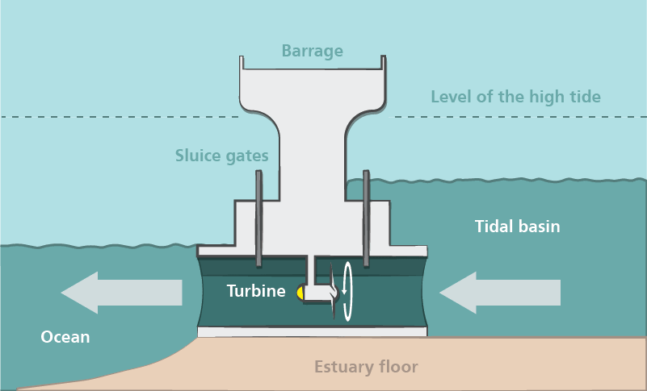
Tides https://www.youtube.com/watch?v=VkTRcTyDSyk
Huge amounts of water move in and out of river mouths each day because of the tides. A tidal barrage is a barrier built over a river estuary to make use of the kinetic energy in the moving water. The barrage contains electricity generators, which are driven by the water rushing through tubes in the barrage.

Slide 24
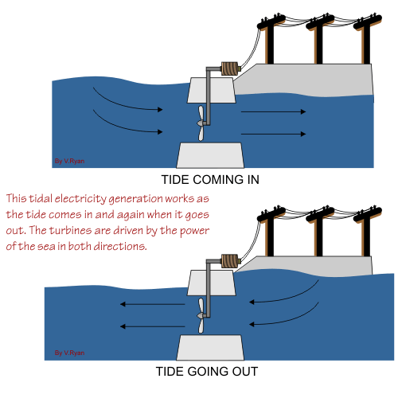

Slide 25
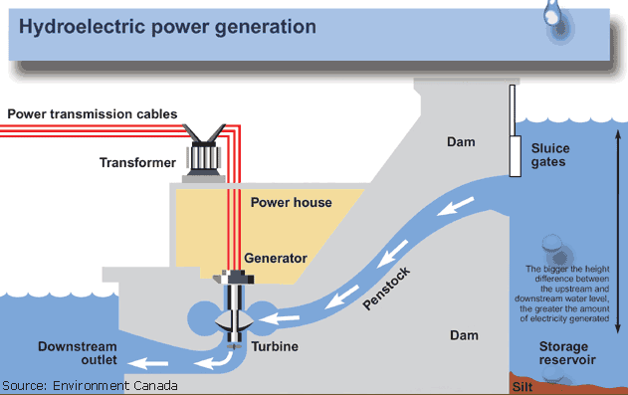
Hydroelectric power
Like tidal barrages, hydroelectric power (HEP) stations use the kinetic energy in moving water. Often, the water comes from behind a dam built across a river valley. The water high up behind the dam contains gravitational potential energy. This is transferred to kinetic energy as the water rushes down through tubes inside the dam. The moving water drives electrical generators, which may be built inside the dam.
Falling water produces hydroelectric power.
The theory is to build a dam on a large river that has a large drop in elevation. The dam stores lots of water behind it in the reservoir. Near the bottom of the dam wall there is the water intake. Gravity causes it to fall through the penstock inside the dam. At the end of the penstock there is a turbine propeller, which is turned by the moving water. The shaft from the turbine goes up into the generator, which produces the power. Power lines are connected to the generator that carry electricity to your home and mine. The water continues past the propeller through the tailrace into the river past the dam.

Slide 26
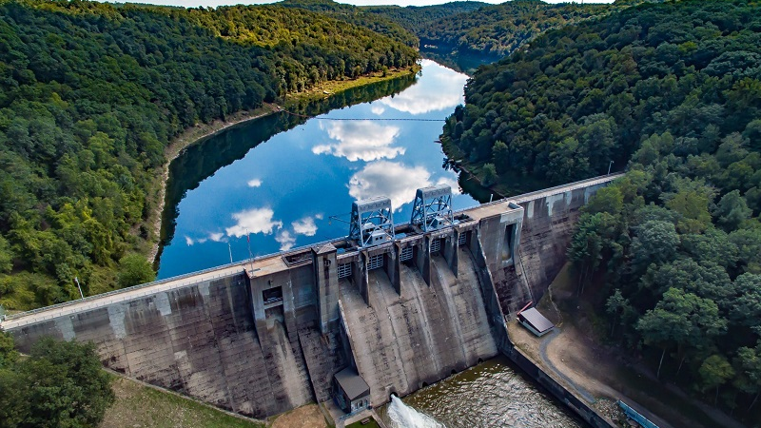

Slide 27
Advantages
Water power in its various forms is a renewable energy resource and there are no fuel costs.
No harmful polluting gases are produced.
Tidal barrages and hydroelectric power stations are very reliable and can be easily switched on.

Slide 28
Disadvantages
It has been difficult to scale up the designs for wave machines to produce large amounts of electricity.
Tidal barrages destroy the habitat of estuary species, including wading birds.
Hydroelectricity dams flood farmland and push people from their homes.
The rotting vegetation underwater releases methane, which is a greenhouse gas.

Slide 29
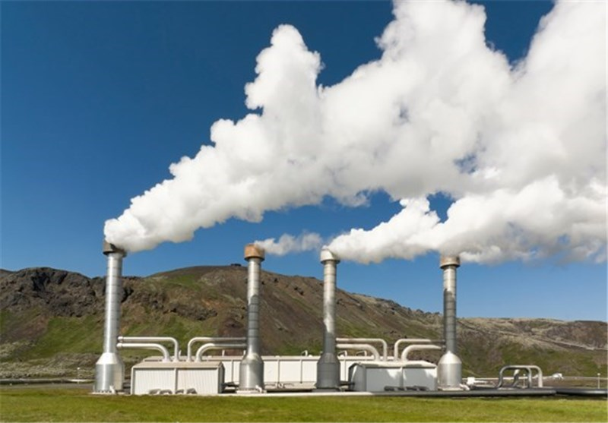
Geothermal power, Iceland
This Photo by Unknown Author is licensed under CC BY

Slide 30
GEOTHERMAL ELECTRICITY

Slide 31
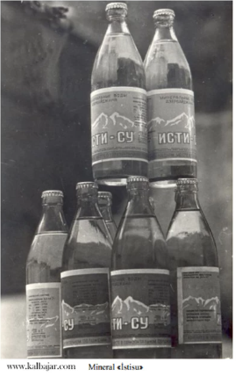
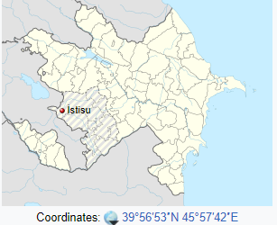
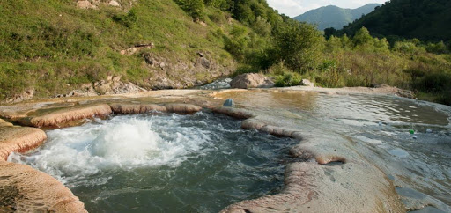
İstisu, Kalbajar
İstisu is a small village in the Kelbajar district of Azerbaijan. Situated in a river valley, İstisu has historically been a resort town, attracting people from all over the USSR to be treated at mineral-springs baths.

Slide 32
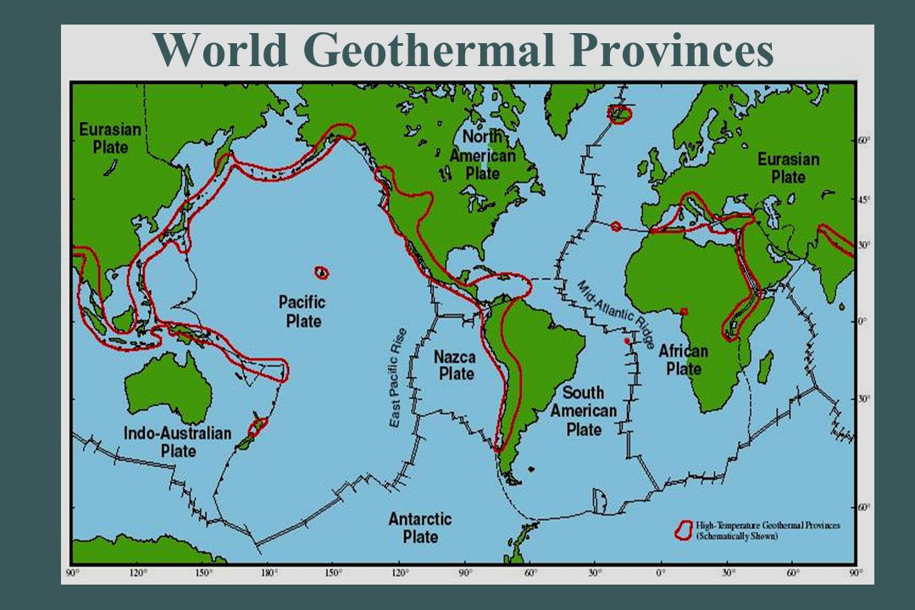

Slide 33
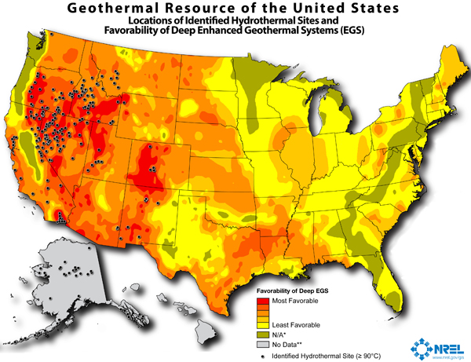

Slide 34
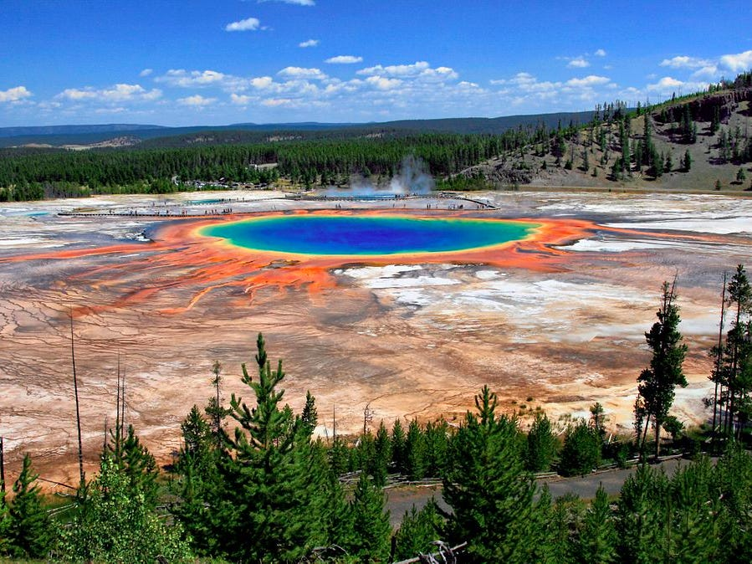
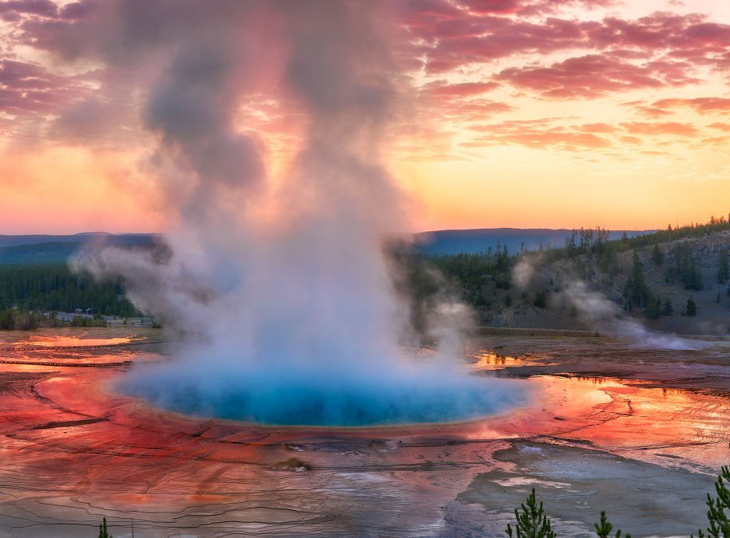
Yellowstone National Park

Slide 35
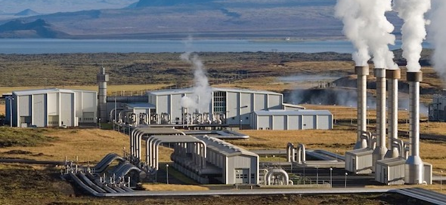
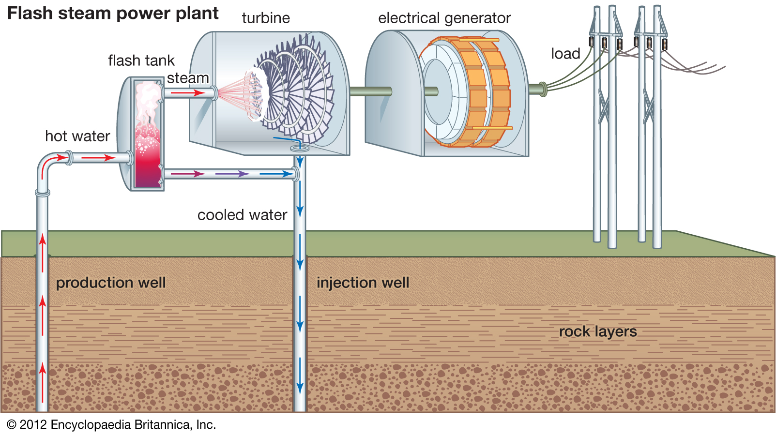
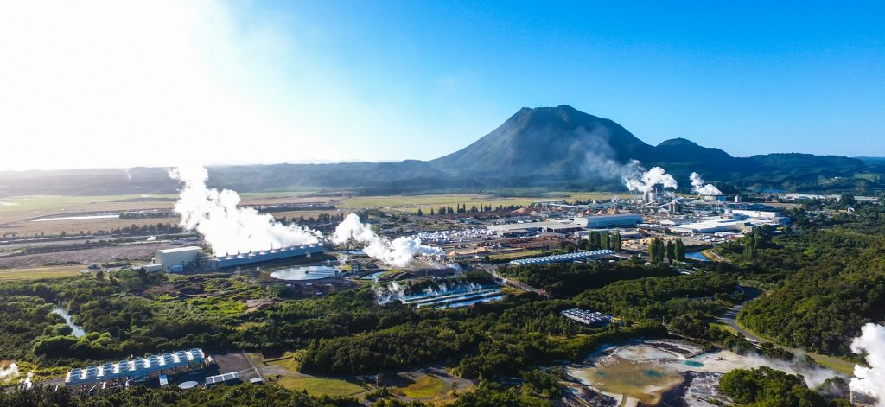
Geothermal power plant

Slide 36
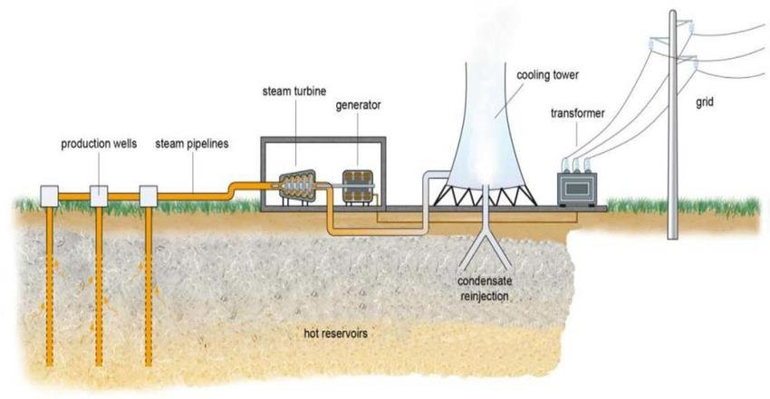

Slide 37
What Are the Advantages of Geothermal Energy?
First and foremost, geothermal energy is extracted from the earth without burning fossil fuels, and geothermal fields produce practically no emissions.
It is an exceptionally constant source of energy, meaning that it is not dependent on neither wind nor sun, and available all year long.
requiring less space for hardware
the life span of geothermal heat pump systems is relatively high. Heat pump pipes even have warranties of between 25 and 50 years, while the pump can usually last for at least 20 years.

Slide 38
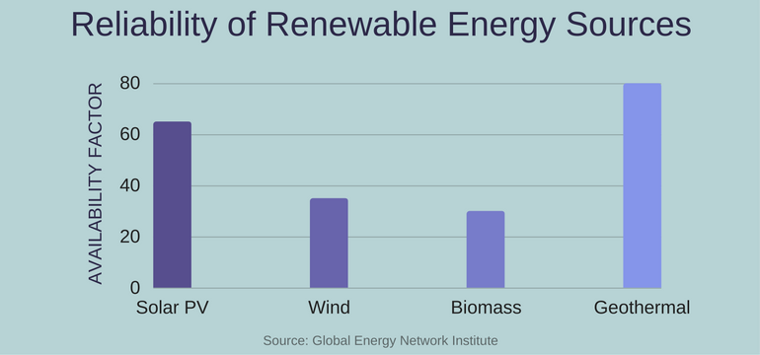

Slide 39
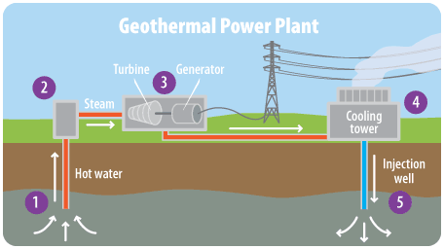
What are the Disadvantages of Geothermal Energy?
despite being considered a sustainable and renewable energy, the chances are that specific locations might cool down after time.
The only non-depletable option is sourcing geothermal energy right from magma but the technology for doing so is still in the process of development.
This option is worth the investment mainly thanks to the fact that magma will be around for billions of years.
the high initial cost for individual households. The need for drilling and installing quite a complex system into one’s home makes the price climb quite high. Nevertheless, the return on such investment is very promising, being able to earn the investment back within 2 to 10 years.

Slide 40
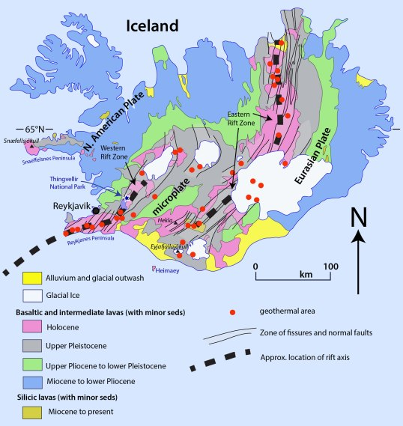
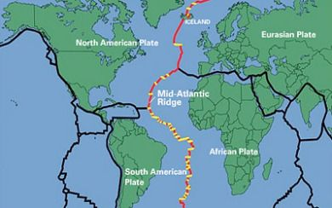
ICELAND

Slide 41
The limitation of this form of energy are:

